Slide 1

Dr. Sajid Iqbal
Department of Computer Science
Bahauddin Zakariya University, Multan

Slide 2
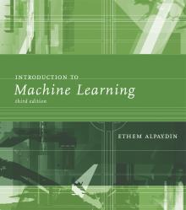
INTRODUCTION TO Machine Learning 3rd Edition
ETHEM ALPAYDIN
© The MIT Press, 2014
alpaydin@boun.edu.tr
http://www.cmpe.boun.edu.tr/~ethem/i2ml3e

Slide 3
Parametric Methods
Chapter Four

Slide 4
4.3 Evaluating the Estimator

Slide 5

Evaluating an Estimator: Bias and Variance
It is specified by parameter $θ$ whose estimate is $d\left(x\right)$ where d is an estimator
Quality of estimation $Q\left(MLE\right)=θ−d(x)$
The difference may be positive or negative. To find consistent values, we square this term $Q\left(MLE\right)={\left[θ−d\left(x\right)\right]}^{2}$
Q is random variable that depends upon sample data,
To find accurate error, Q is averaged for all instances
Mean Square Error:
Bias of estimator:
$$\begin{aligned}R\left(d,θ\right)=E\left[{\left(θ−d\left(x\right)\right)}^{2}\right]\#\end{aligned}$$
$$\begin{aligned}b_{θ}\left(d\right)=E\left[d\left(x\right)\right]−θ\#\end{aligned}$$

Slide 6

Mean Estimation
Let X is sample from some population with unknown $μ$ and $σ^{2}$
X is made with N independent draws (iid) from normal distribution
Take n samples i.e. $X=[X_{1},X_{2},…,X_{n}]$
Let we denote the BIAS of estimator as $b_{θ}\left(d\right)$ then
An Unbiased estimator has bias $b_{θ}\left(d\right)=0$

Slide 7
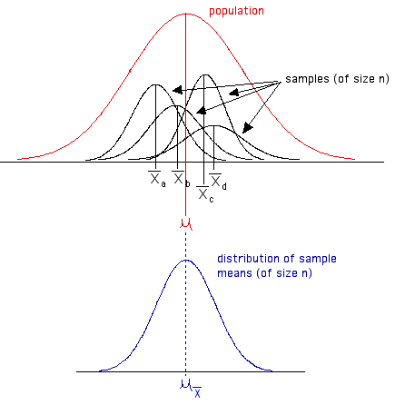


Mean Estimation for Unbiased Estimator
Sample average $m$ is estimator of mean population mean $μ$
As the number of samples increase, the average of $m$ will get closer to actual mean $μ$, $Var\left(m\right)→0 as N→∞$
Hence E[m] is unbiased estimator of population mean
$$E\left[m\right]=E[\sum_{t}{\frac{x^{t}}{N}]=\frac{1}{N}\sum_{t}{x^{t}}=\frac{Nμ}{N}=μ }$$

Slide 8




Variance Estimation for Unbiased Estimator
Sample variance $s^{2}$ is an estimator of population variance $σ^{2}$
As the sample size $N$ increases, the $m$ (sample mean) deviates less from $μ$ (population mean) leading to small variance
$$Var\left(m\right)=Var(\sum_{t}{\frac{x^{t}}{N})}$$
$$=\frac{\sum{Var\left(x^{t}\right)}}{\sum{N}}=\frac{\sum{Var\left(x^{t}\right)}}{N^{2}}$$
$$=\frac{\sum{σ^{2}}}{N^{2}}=\frac{Nσ^{2}}{N^{2}}$$
$$=\frac{σ^{2}}{N}$$
$$σ^{2}=\frac{\sum{{\left(x−μ\right)}^{2}}}{N}$$
$$Var\left(m\right)=\frac{σ^{2}}{N}$$

Slide 9



Variance Estimation of Unbiased Estimator
Let $s^{2}$ is estimator of population variance $σ^{2}$
$s^{2}=\frac{{\left(\sum_{t}{(x^{t}−m}\right)}^{2}}{N}$
$=\frac{\sum_{t}{{[\left(x^{t}\right)}^{2}−2x^{t}m+m^{2}]}}{N}=\frac{\sum_{t}{{\left(x^{t}\right)}^{2}−2m\sum_{t}{x^{t}}+\sum_{t}{m^{2}}}}{N}$
$=\frac{\sum_{t}{{\left(x^{t}\right)}^{2}−2mNm+Nm^{2}}}{N}$
$=\frac{\sum_{t}{{\left(x^{t}\right)}^{2}−2Nm^{2}+Nm^{2}}}{N}$
$=\frac{\sum_{t}{{\left(x^{t}\right)}^{2}−Nm^{2}}}{N}$
$∴m=\frac{\sum_{t}{x^{t}}}{N}→\sum_{t}{x^{t}}$=Nm
$$s^{2}=\frac{{\left(\sum_{t}{(x^{t}−m}\right)}^{2}}{N}=\frac{\sum_{t}{{\left(x^{t}\right)}^{2}−Nm^{2}}}{N}$$

Slide 10



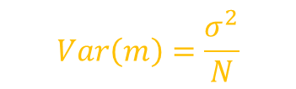

The sample variance is given by
$s^{2}=\frac{\sum_{t}{{\left(x^{t}\right)}^{2}−Nm^{2}}}{N}$
$E\left[s^{2}\right]=\frac{\sum_{t}{E\left[{\left(x^{t}\right)}^{2}\right]−NE\left[m^{2}\right]}}{N}$
$=$ $\sum_{t}{\frac{E\left[{\left(x^{t}\right)}^{2}\right]}{N}−\frac{NE\left[m^{2}\right]}{N}}$
$=E[s^{2}]=\sum_{t}{\frac{E\left[{\left(x^{t}\right)}^{2}\right]}{N}−E[m^{2}]}$
$E\left[{\left(x^{t}\right)}^{2}\right]=σ^{2}+μ^{2}$
$E\left[m^{2}\right]=\frac{σ^{2}}{N}+μ^{2}$
Plugging the values in $E\left[s^{2}\right]$ equation
$$E\left[m\right]=μ$$
$$Var\left(m\right)=\frac{σ^{2}}{N}$$
$$∴Var\left(X\right)=E\left[X^{2}\right]−E{\left[X\right]}^{2}$$
$E\left[X^{2}\right]=Var\left(X\right)+E{\left[X\right]}^{2}$
$$E\left[X^{2}\right]=Var\left(X\right)+μ^{2}$$
$$E\left[s^{2}\right]=\frac{1}{N}(N\left(σ^{2}+μ^{2}\right)−\left(\frac{σ^{2}}{N}+μ^{2}\right)=\frac{N−1}{N}σ^{2}$$

Slide 11

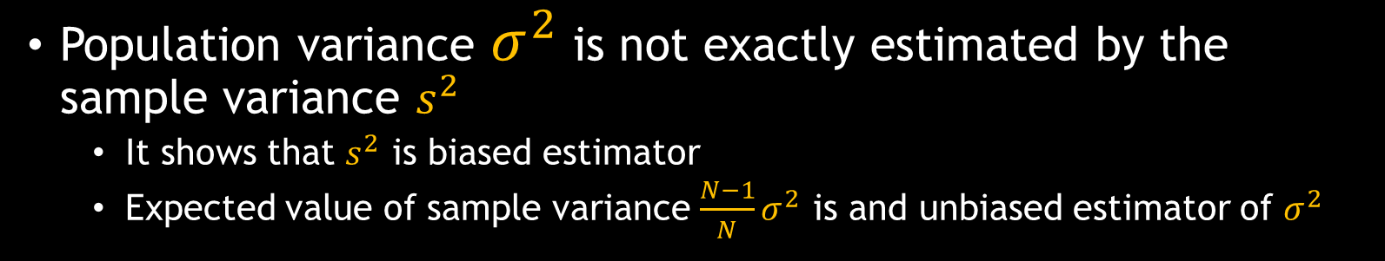

$$E\left[s^{2}\right]=\frac{1}{N}(N\left(σ^{2}+μ^{2}\right)−\left(\frac{σ^{2}}{N}+μ^{2}\right)=\frac{N−1}{N}σ^{2}$$
$$E\left[s^{2}\right]=\frac{N−1}{N}σ^{2}$$
$$σ^{2}≠E[s^{2}]$$
Population variance $σ^{2}$ is not exactly estimated by the sample variance $s^{2}$
It shows that $s^{2}$ is biased estimator
Expected value of sample variance $\frac{N−1}{N}σ^{2}$ is and unbiased estimator of $σ^{2}$

Slide 12
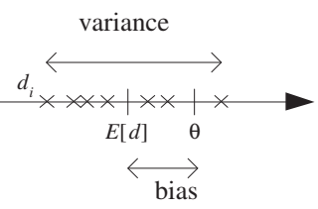
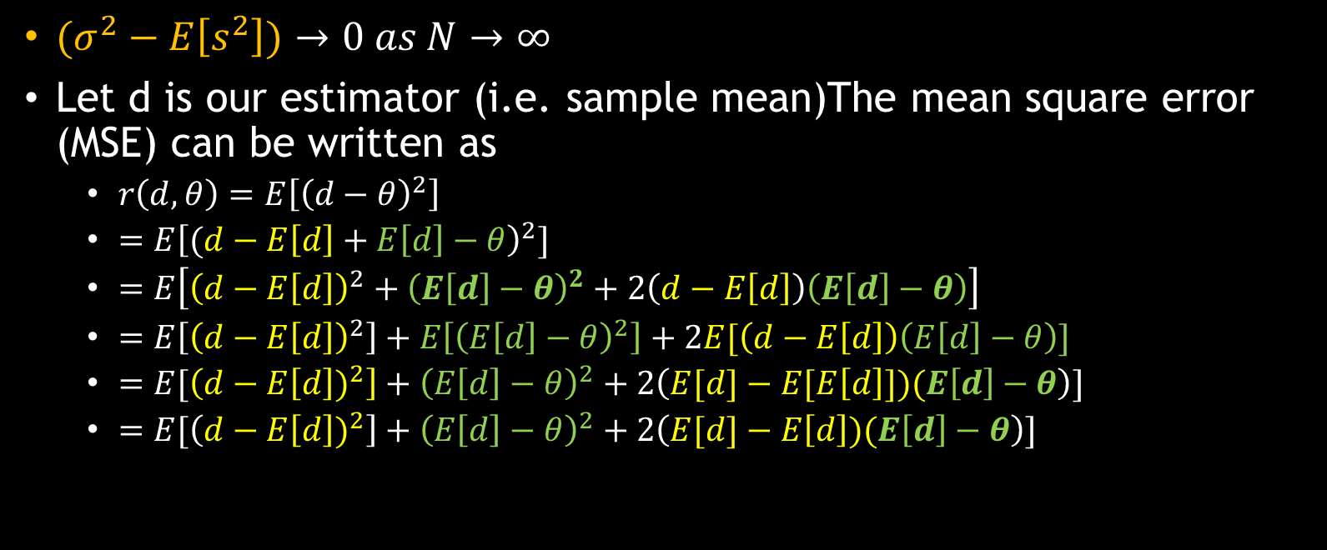
Variance estimation of unbiased estimator
$(σ^{2}−E\left[s^{2}\right])→0 as N→∞$
Let d is our estimator (i.e. sample mean)The mean square error (MSE) can be written as
$r\left(d,θ\right)=E\left[{\left(d−θ\right)}^{2}\right]$
$=E{\left[(d−E\left[d\right]+E\left[d\right]−θ\right)}^{2}]$
$=E\left[{\left(d−E\left[d\right]\right)}^{2}+{\left(E\left[d\right]−θ\right)}^{2}+2\left(d−E\left[d\right]\right)\left(E\left[d\right]−θ\right)\right]$
$=E\left[{\left(d−E\left[d\right]\right)}^{2}\right]+E\left[{\left(E\left[d\right]−θ\right)}^{2}\right]+2E[\left(d−E\left[d\right]\right)\left(E\left[d\right]−θ\right)]$
$=E[\left(d−E{\left[d\right])}^{2}\right]+{\left(E\left[d\right]−θ\right)}^{2}+2\left(E[d]−E[E\left[d\right]])(E\left[d\right]−θ\right)]$
$=E[\left(d−E{\left[d\right])}^{2}\right]+{\left(E\left[d\right]−θ\right)}^{2}+2\left(E[d]−E\left[d\right])(E\left[d\right]−θ\right)]$
Variance Bias

Slide 13


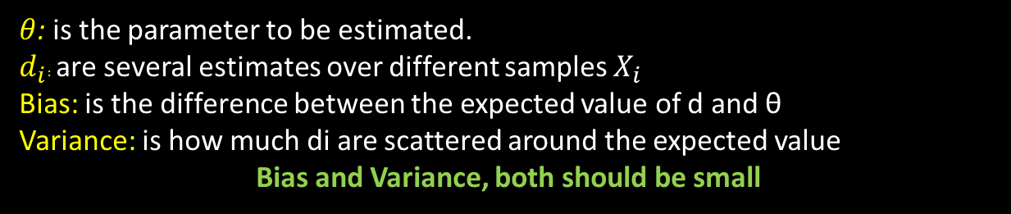
$$E[\left(d−E{\left[d\right]}^{2}\right]+{\left(E\left[d\right]−θ\right)}^{2}]$$
Variance measures how much, on average, $d_{i}$ vary around the expected value $E[d]$
Bias measures how much the expected value varies from the correct value θ
Error is the sum of these two terms, the variance and the square of the bias
$r\left(d,θ\right)=Var\left(d\right)+{\left[b_{θ}\left(d\right)\right]}^{2}$
$θ$: is the parameter to be estimated.
$d_{i}:$ are several estimates over different samples $X_{i}$
Bias: is the difference between the expected value of d and θ
Variance: is how much di are scattered around the expected value
Bias and Variance, both should be small

Slide 14
4.4 The Bayes Estimator

Slide 15

Density Estimation (DE)
DE involves
selecting a probability distribution function i.e. pdf(x)
the parameters of that distribution i.e. mean and variance
that best explains the joint probability distribution of the observed data (X)
DE is challenging so we estimate points like mean
There are multiple density estimation methods i.e. MLE and MAP
Maximum likelihood estimation
Try to maximize the probability of observing the data from the joint probability distribution given a specific probability distribution and its parameters
$p(X|θ)$

Slide 16
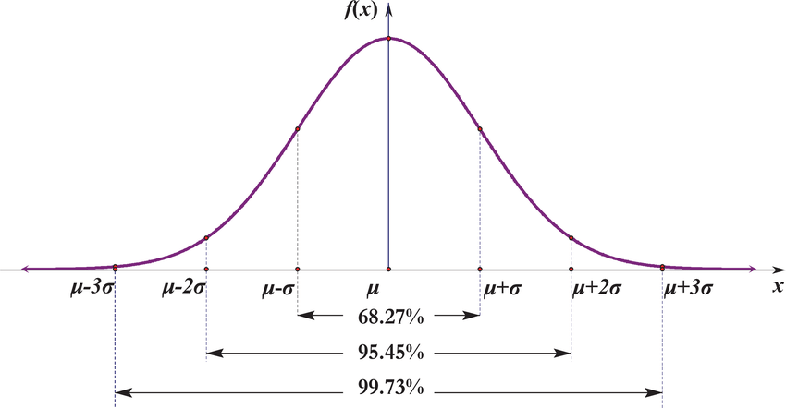
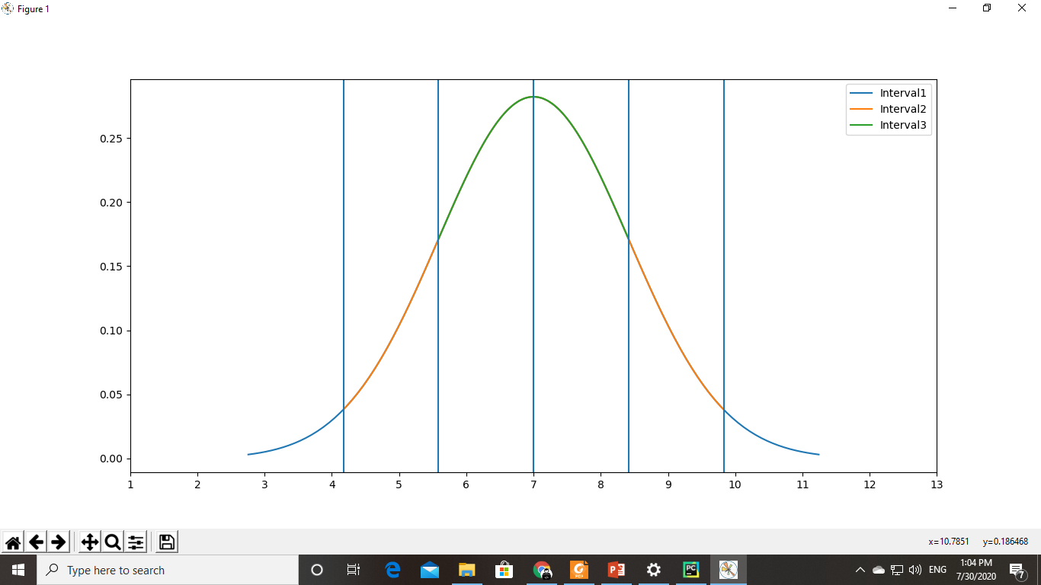


The Bayes’ Estimator
For some densities, we may know the range of values that a parameter can take on.
This is known as prior knowledge
Let $θ$ is approximately normal
With $90\%$ confidence, $θ$ lies between $5$ and $9$, symmetrically around $7$
We can write $p(θ)$ to be normal with mean $7$
Z-score: It is the position of a raw score in terms of its distance from the mean, when measured in standard deviation units
$$\begin{aligned}z=\frac{θ−μ}{σ}\#\end{aligned}$$

Slide 17
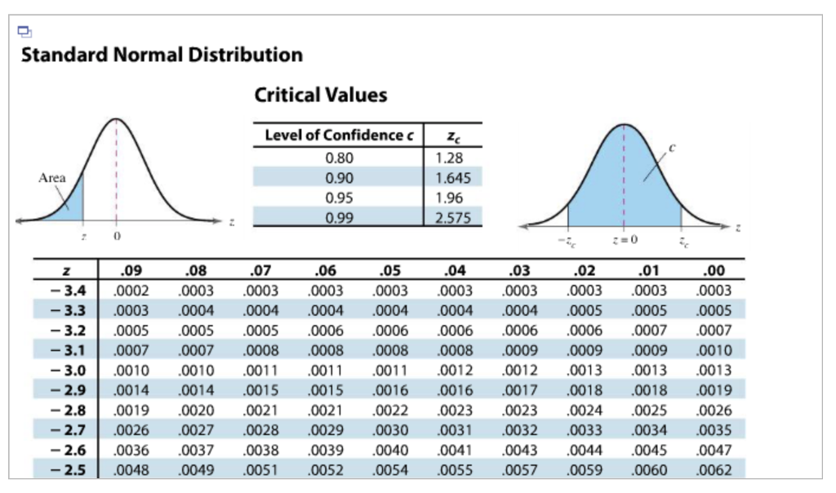
Z-score table

Slide 18
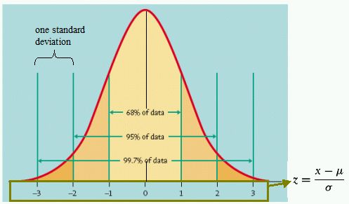
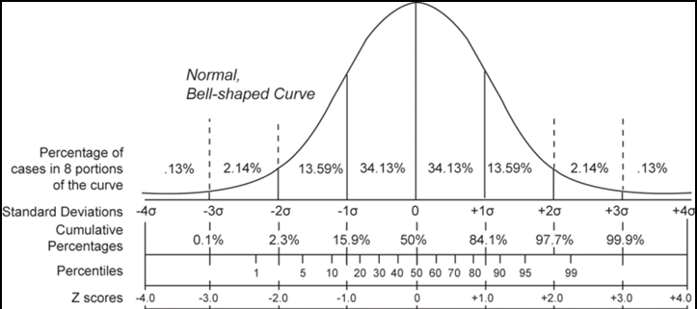
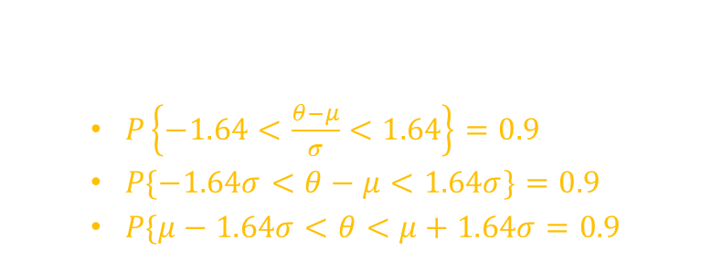

Bayes Estimator
Z-score is related to %age area under curve
$P\left\{−1.64<\frac{θ−μ}{σ}<1.64\right\}=0.9$
$P\{−1.64σ<θ−μ<1.64σ\}=0.9$
$P\{μ−1.64σ<θ<μ+1.64σ=0.9$
90% of area is covered by 1.64$σ$ with difference of 2 around mean
Take $1.64σ=2→σ=\frac{2}{1.46}$
We can now assume that
$p(θ)\sim N(7,{\left(\frac{2}{1.64}\right)}^{2})$

Slide 19


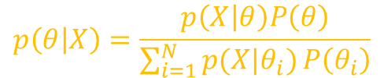
Bayes Estimator
$Prior p(θ)$: Prior density tells us likely values that θ may take before looking at the sample
$Likelihood p\left(X | θ\right):$ likelihood density given by sample data
$Evidence p(X)$: probability of the observation used to update the prior
$Posterior p\left(θ | X\right)$: likely of parameter $θ$after looking at sample
$$p\left(θ | X\right)=\frac{p\left(X | θ\right)P\left(θ\right)}{P\left(X\right)}$$
$$p\left(θ | X\right)=\frac{p\left(X | θ\right)P\left(θ\right)}{\sum_{i=1}^{N}{p(X|θ_{i})}P\left(θ_{i}\right)}$$

Slide 20

Maximum A Posteriori
Maximum a Posteriori or MAP
A Bayesian-based approach to estimate a distribution and model parameters that best explain an observed dataset
Can be used for regression and classification
MAP provides an alternate framework to maximum likelihood estimation for machine learning
$$p\left(θ | X\right)=\frac{p\left(X | θ\right)P\left(θ\right)}{P\left(X\right)}$$

Slide 21
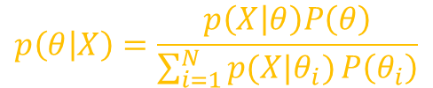



Maximum A Posterior Estimate
$$θ_{MAP}=\arg{\max_{θ}{p(θ|X)}}$$
Likelihood estimation: $x\sim p\left(x\right)$ (x belongs to prob. dist.)
As we have sample in hand, P(X) does not depend upon the value of parameter $θ,$so we can eliminate it
$p\left(θ | X\right)=p\left(X | θ\right)P\left(θ\right)$
$p(X)$ is just a normalizing constant that can be ignored
$$p\left(θ | X\right)=\frac{p\left(X | θ\right)P\left(θ\right)}{P(X)}$$
$$p\left(θ | X\right)=\frac{p\left(X | θ\right)P\left(θ\right)}{\sum_{i=1}^{N}{p(X|θ_{i})}P\left(θ_{i}\right)}$$

Slide 22
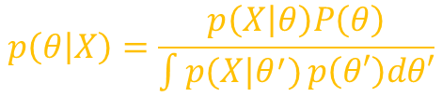

Evaluating the integrals is quite difficult
Use of Maximum A Posteriori (MAP) estimate makes it easier
$maximize P(X|θ)∗P(θ)$
$θ_{MAP}=\arg{\max_{θ}{p(θ|X)}}$
Thus replacing a whole density with a single point eliminates the integral and can be used as
$p\left(x | X\right)=p(x|θ_{MAP})$
$y_{MAP}=g(x|θ_{MAP})$
If we do not prefer some $θ$, then prior density is flat and posterior has the same form as that of likelihood
And MAP estimate will be equal to ML estimate
$$p\left(θ | X\right)=\frac{p\left(X | θ\right)P\left(θ\right)}{\int{p(X|θ^{′})}p\left(θ′\right)dθ′}$$

Slide 23

Bayesian Estimator
MAP estimate is given by $θ_{MAP}=\arg{\max_{θ}{P(θ|X)}}$
ML estimate is given by $θ_{ML}=\arg{\max_{θ}{p\left(X | θ\right)}}$
This is another way to estimate the parameter defined as
$θ_{Bayes}=E\left[θ | X\right]=\int{θp\left(θ | X\right)dθ→}\frac{1}{N}\sum{θ.p(θ|X)}$
Best estimate of a random variable is its mean

Slide 24
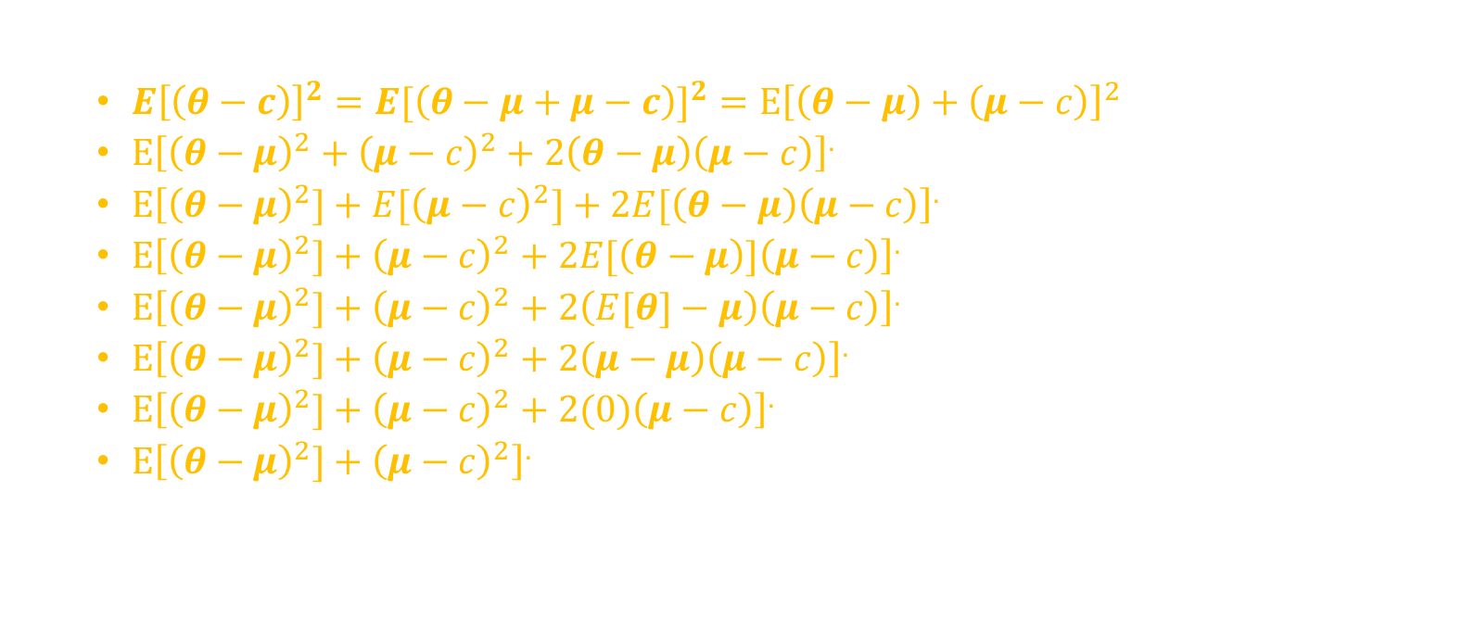

$$E{\left[\left(θ−c\right)\right]}^{2}=E\left[{\left(θ−μ\right)}^{2}\right]+{\left(μ−c\right)}^{2}$$
Proof:
$E{\left[\left(θ−c\right)\right]}^{2}=E[{\left(θ−μ+μ−c\right)]}^{2}=E{\left[\left(θ−μ\right)+\left(μ−c\right)\right]}^{2}$
$E{\left[{\left(θ−μ\right)}^{2}+{\left(μ−c\right)}^{2}+2\left(θ−μ\right)\left(μ−c\right)\right]}^{.}$
$E{\left[{\left(θ−μ\right)}^{2}]+E[{\left(μ−c\right)}^{2}]+2E[\left(θ−μ\right)\left(μ−c\right)\right]}^{.}$
$E{\left[{\left(θ−μ\right)}^{2}]+{\left(μ−c\right)}^{2}+2E[\left(θ−μ\right)]\left(μ−c\right)\right]}^{.}$
$E{\left[{\left(θ−μ\right)}^{2}]+{\left(μ−c\right)}^{2}+2\left(E[θ]−μ\right)\left(μ−c\right)\right]}^{.}$
$E{\left[{\left(θ−μ\right)}^{2}]+{\left(μ−c\right)}^{2}+2\left(μ−μ\right)\left(μ−c\right)\right]}^{.}$
$E{\left[{\left(θ−μ\right)}^{2}]+{\left(μ−c\right)}^{2}+2(0)\left(μ−c\right)\right]}^{.}$
$E{\left[{\left(θ−μ\right)}^{2}]+{\left(μ−c\right)}^{2}\right]}^{.}$

Slide 25

Bayesian Estimator
Let us say θ is the variable we want to predict with E[θ] = μ
if $c$ is our estimate of $θ$, then
The term is minimum if $\left(μ=c\right)$
$E{\left[\left(θ−c\right)\right]}^{2}=E\left[{\left(θ−μ\right)}^{2}\right]+{\left(μ−c\right)}^{2}$
For normal density the mode is expected value
If $p\left(θ | X\right)$ is normal then both estimations are equal
$θ_{Bayes}=θ_{MAP}$

Slide 26
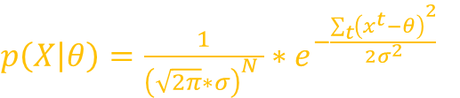

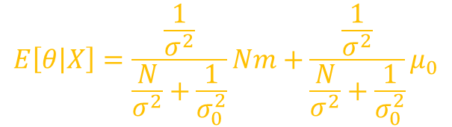
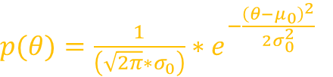
Bayesian Estimator
Example
Let suppose $x^{t}∼N (θ, σ^{2})$ and $θ∼N(μ_{0}, σ_{0}^{2})$where $σ^{2}$,$μ_{0} and σ_{0}^{2}$ are known
It can be shown that $P(θ|X)$ is normal with
Thus Bayes estimator is weighted average of the prior mean $μ_{0}$ and sample mean $m$
with weights being inversely proportional to their variances
$p\left(X | θ\right)=\frac{1}{{\left(\sqrt{2π}∗σ\right)}^{N} }∗e^{−\frac{\sum_{t}{{\left(x^{t}−θ\right)}^{2}}}{2σ^{2}}}$
$p(θ)=\frac{1}{\left(\sqrt{2π}∗σ_{0}\right)}∗e^{−\frac{{\left(θ−μ_{0}\right)}^{2}}{2σ_{0}^{2}}}$
$$E\left[θ | X\right]=\frac{\frac{1}{σ^{2}}}{\frac{N}{σ^{2}}+\frac{1}{σ_{0}^{2}}}Nm+\frac{\frac{1}{σ^{2}}}{\frac{N}{σ^{2}}+\frac{1}{σ_{0}^{2}}}μ_{0}$$

Slide 27

As $N→∞, θ_{Bayes}→μ$
When $σ_{0}^{2}$ is small, we have little prior uncertainty regarding the correct value of $θ$,
when N is small, our prior guess $μ_{0}$ has a higher effect

Slide 28



Thanks for watching
Dr. Sajid Iqbal
Assistant Professor
Department of Computer Science
Bahauddin Zakariya University, Multan
sajidiqbal.pk@gmail.com
https://github.com/sajjo79/Design_and_Analysis_of_Algorithms
Allah Hafiz
COMEDXD

Slide 29
References
https://www.statlect.com/fundamentals-of-statistics/variance-estimation
https://www.statlect.com/fundamentals-of-statistics/mean-estimation#NIID
https://ocw.mit.edu/courses/mathematics/18-05-introduction-to-probability-and-statistics-spring-2014/readings/MIT18_05S14_Reading10b.pdf

